Slide 1
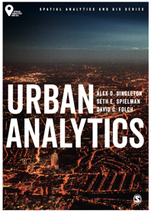
An Introduction to Urban Analytics
Alex D Singleton, Seth E Spielman, David C Folch (2017) Urban Analytics. London: Sage.

Slide 2
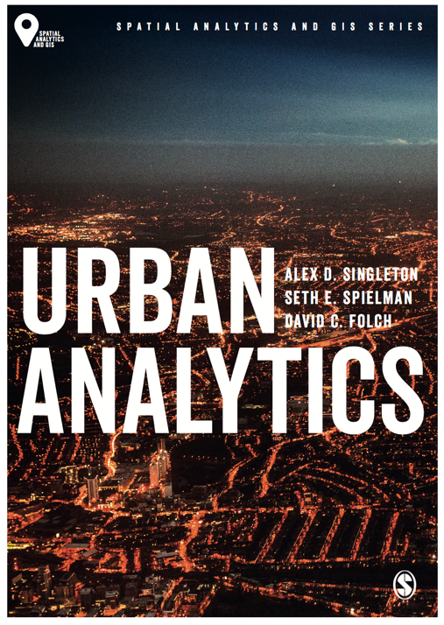
Introduction: Textbook
Alex D Singleton, Seth E Spielman, David C Folch (2017) Urban Analytics. London: Sage.

Slide 3
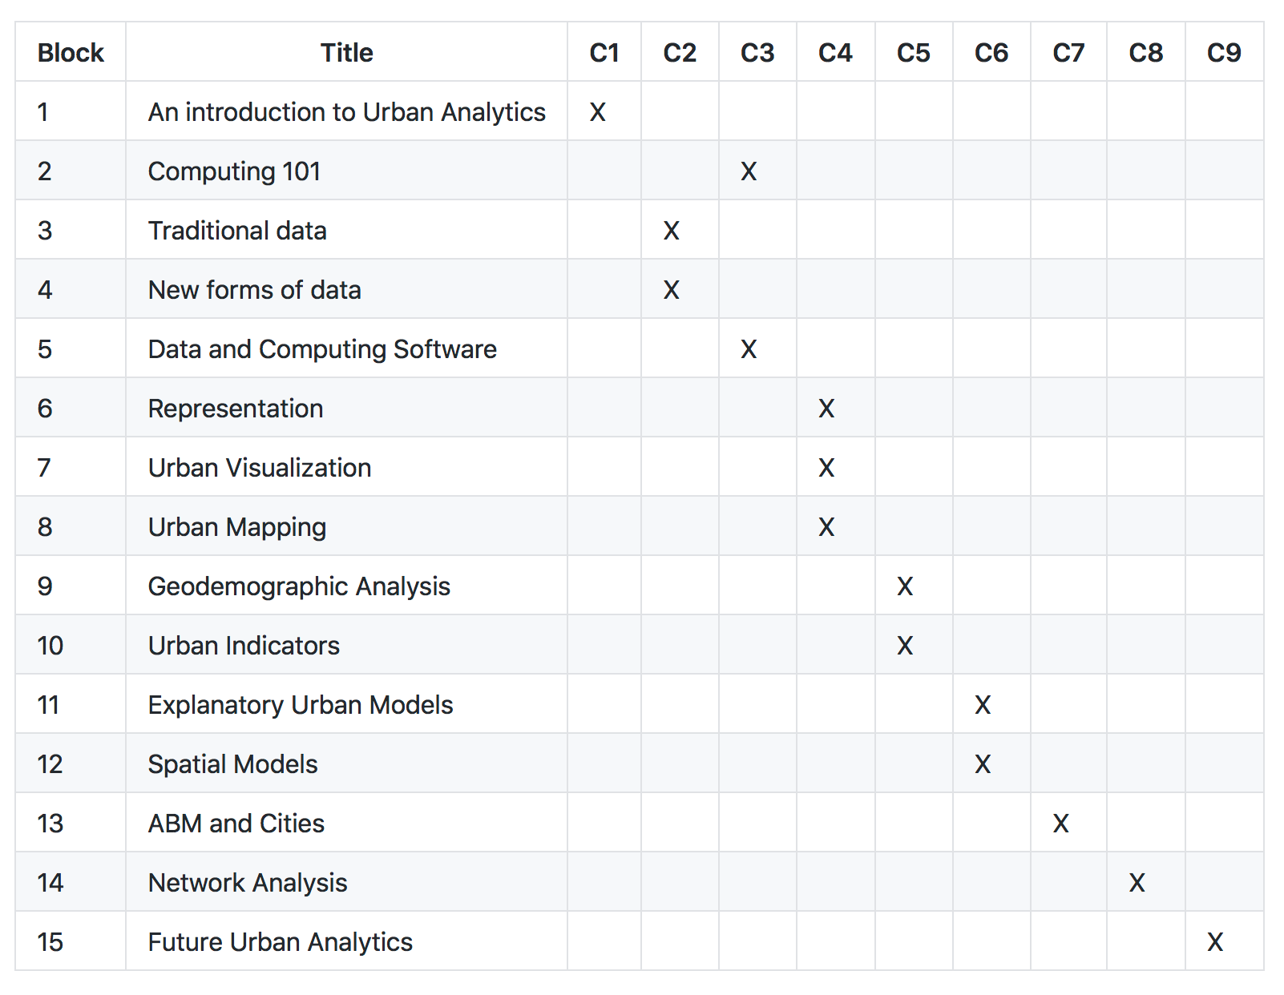
Introduction: Lectures
Course Materials : https://github.com/alexsingleton/urban_analytics

Slide 4
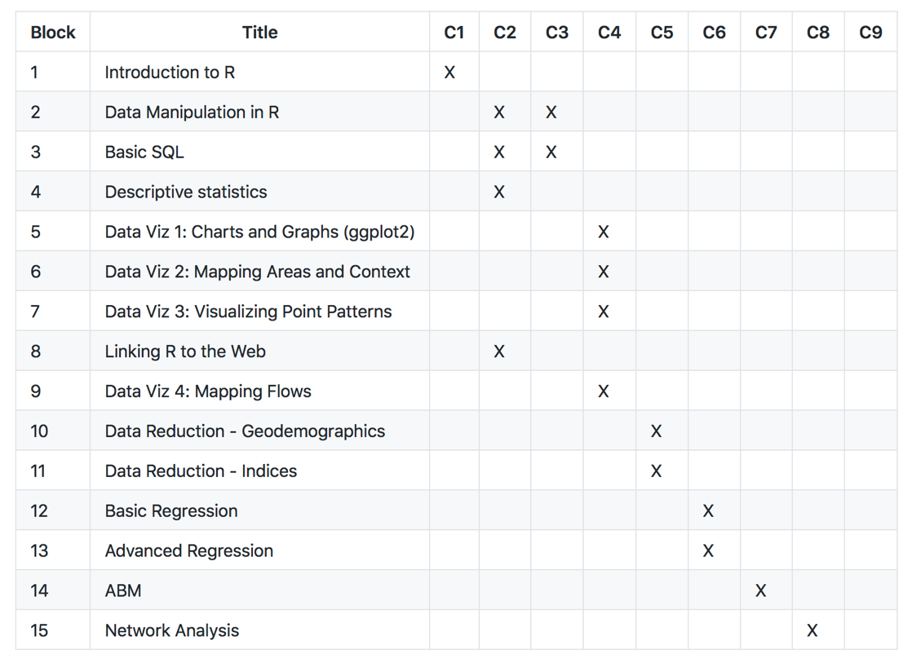
Introduction: Labs

Slide 5
Learning Objectives
Introduce the textbook, structure and integration of learning materials
Provide an overview of Urban Analytics
The majority of future population growth will be concentrated in urban areas.
The planning and management of population change creates a range of challenges for cities.
New forms of technology are increasingly embedded into city systems and are providing a wealth of new data.
Urban analytics represents a methodological toolkit for studying and managing data-rich cities.

Slide 6
Urban Analytics
The multi-disciplinary area of research concerned with using new and emerging forms of data, alongside computational and statistical techniques, to study cities.
The use of data and statistics in the study of cities is nothing new; but what is new is the quantity and variety of data available about cities
What can, or should, one do with all of this data?

Slide 7
Human Settlements and Urbanization
United Nations (UN) estimate that the global population reached 7.3 billion people
This will have grown to 9.7 billion by 2050 (United Nations 2015)
Fundamentally changes how we (as a species) interact with one another and our natural environment
Creating a range of challenges for the planning and management of urban areas.

Slide 8
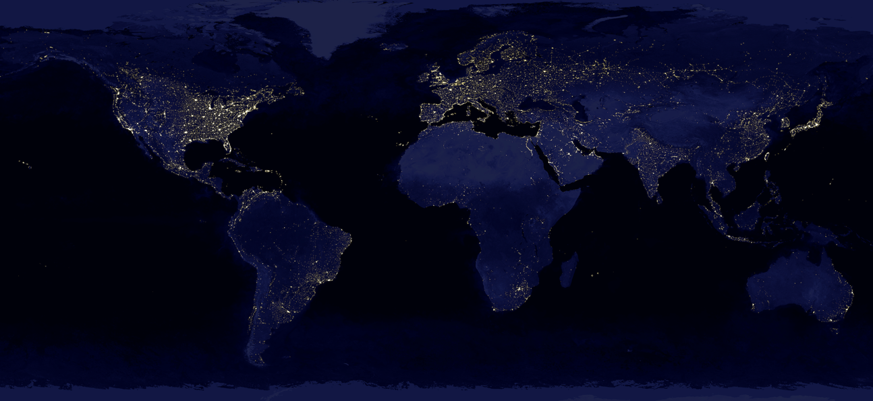
Urbanization at night
Source: Data courtesy Marc Imhoff of NASA GSFc and Christopher Elvidge of NOAA NGDC. Image by Craig Mayhew and Robert Simmon, NaSa GSFc

Slide 9
Human Settlements and Urbanization
Information technologies connect cities in a global network
Also enable new ways of managing cities
Advances in instruments that can monitor activities within or attributes of urban environments

Slide 10
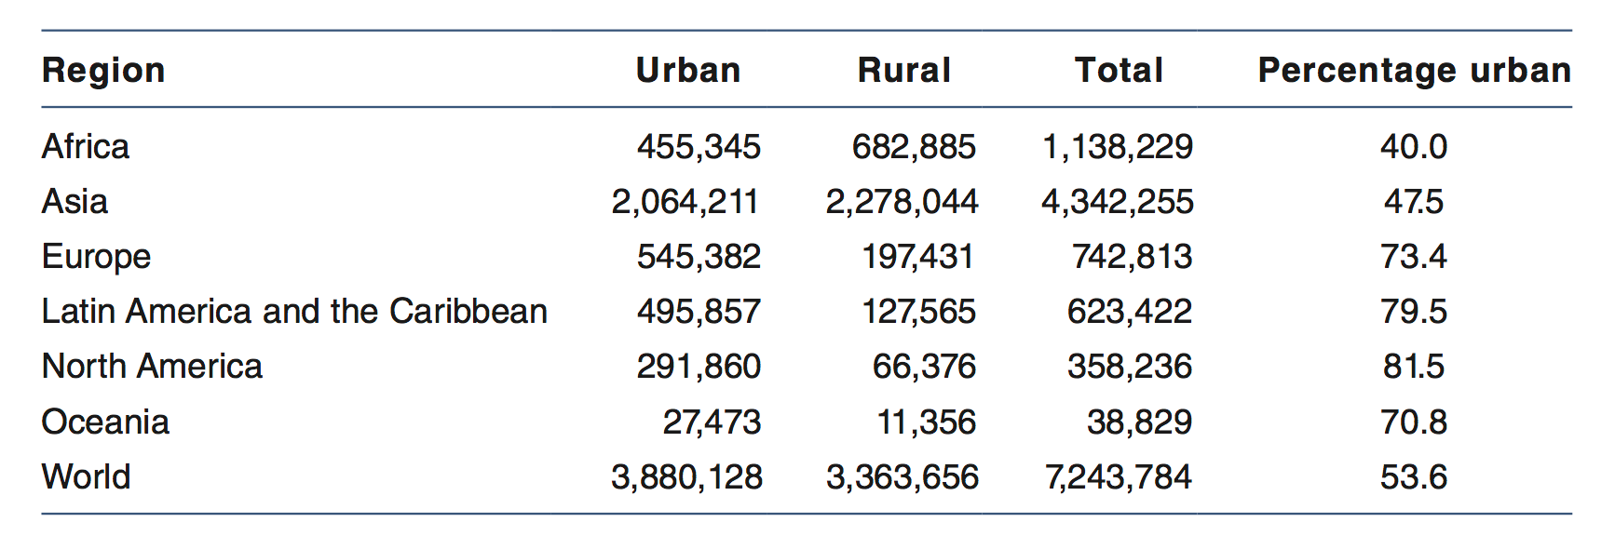
Human Settlements and Urbanization
Cities are dynamic systems that evolve from the bottom up and over time
By 2050; 37 percent of new projected urban population growth will be attributable to just three countries in Africa and Asia, namely, China, India, and Nigeria
Note: Population is in thousands; Source: United Nations, World Urbanization Prospects, 2015

Slide 11
Human Settlements and Urbanization
Some cities expand rapidly, others are shrinking – e.g.
Macroeconomic trends
Decline of manufacturing
Environmental disasters
Urban areas require careful management, planning and investment to avoid the negative societal impacts

Slide 12
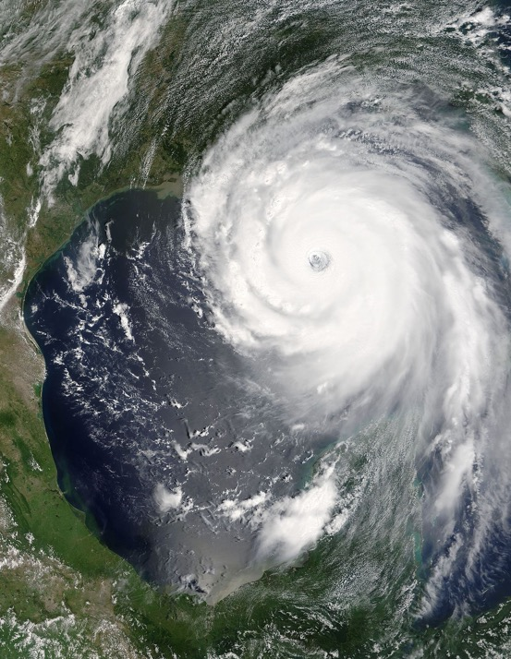

Human Settlements and Urbanization
Source: US Coast Guard photo by Petty Officer 2nd Class NyxoLyno Cangemi (Wikipedia)
Source: Jeff Schmaltz, MODIS Rapid Response Team

Slide 13
Human Settlements and Urbanization
Hurricane Katrina struck the Gulf Coast of the United States in August 2005
City of New Orleans, Louisiana
Levees failed
80 percent of the city flooded under 15 to 20 feet (4.5 to 6 m) of water
1,353 direct fatalities
275,000 homes damaged or destroyed
Financial costs in excess of $100 billion

Slide 14
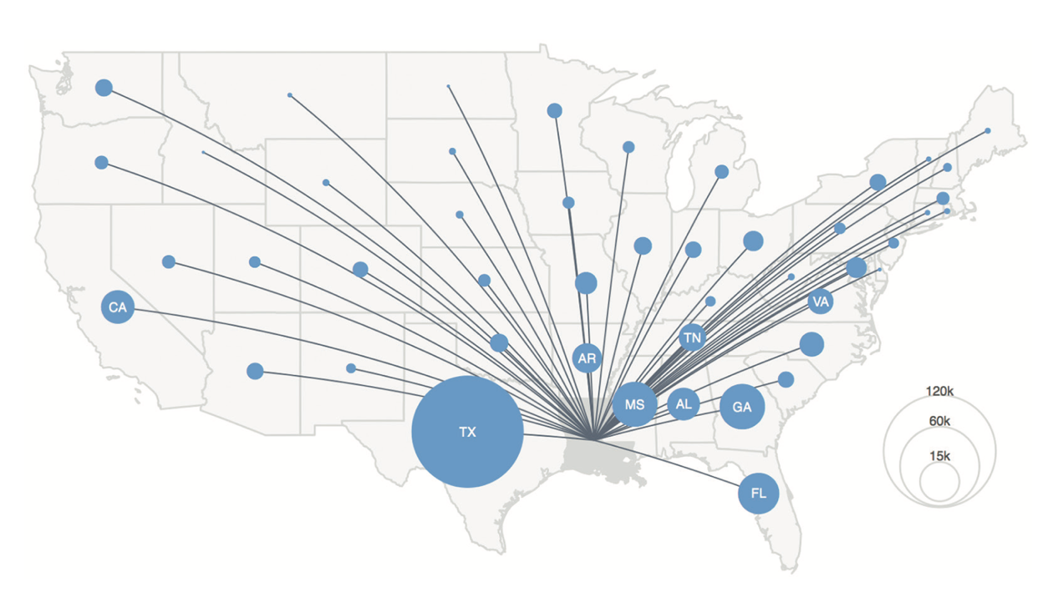
Human Settlements and Urbanization
States where migrants housed within Louisiana during 2005 had moved to as of 2006

Slide 15
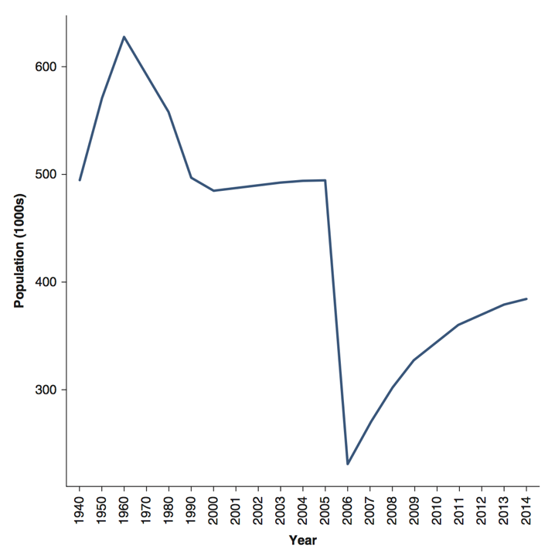
Human Settlements and Urbanization
Population change in New Orleans between 1950 and 2014
Source: Authors’ own; data – US Census Bureau, Population of the Largest 100 Urban Places 1940–2016

Slide 16
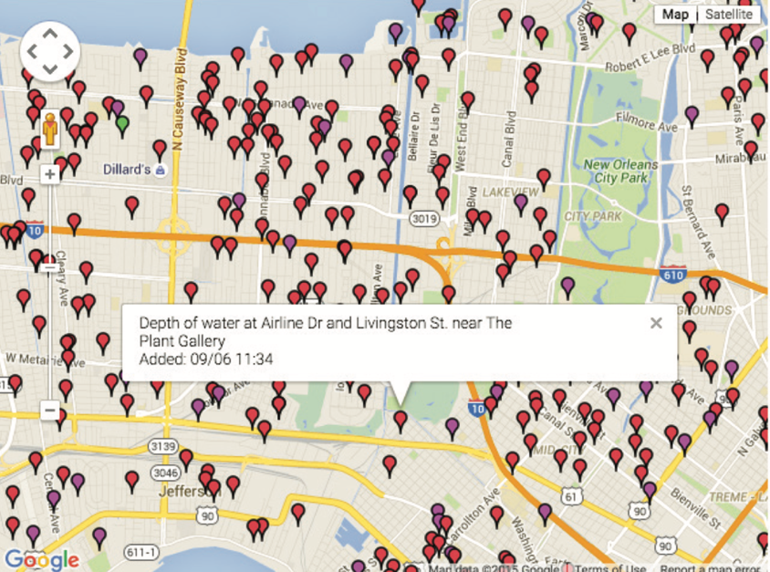
Human Settlements and Urbanization
An early map “mashup” created in the aftermath of Hurricane Katrina
Source: Website was developed by Jonathan Mendez and Greg Stoll and is available online (http://gregstoll.dyndns.org/scipionus)

Slide 17
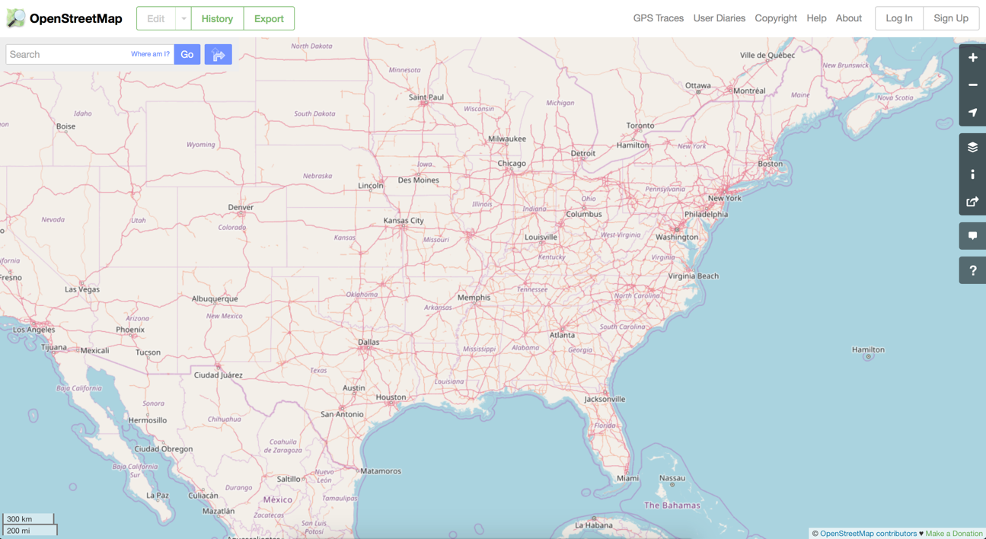
Urban Data in Context
New York

Slide 18
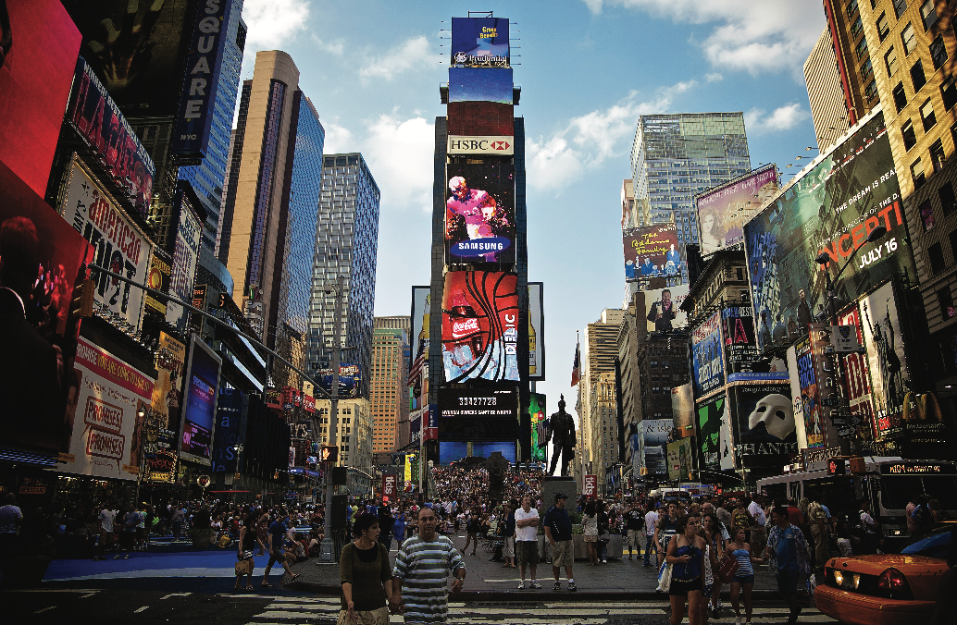
Urban Data in Context
What data or technologies might exist in this picture?
Times Square, NYC: Technology is integral to how cities can be managed and studied
Source: Photograph by Aurelien Guichard CC BY-SA (Flickr)

Slide 19
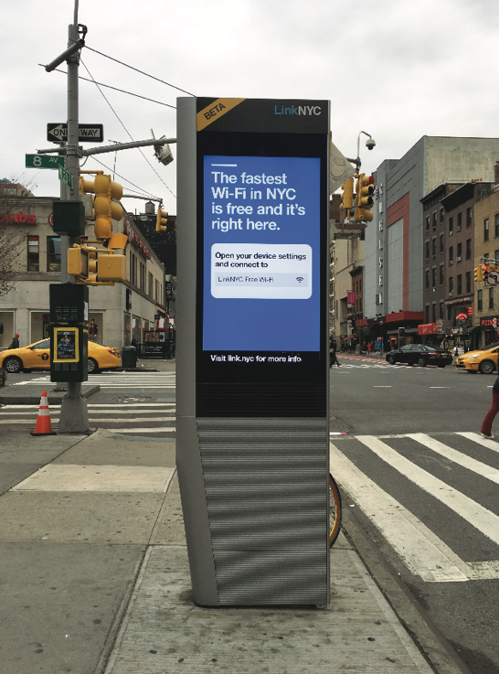
Urban Data in Context
GPS
Cell Phones
Cellular Networks
Satellite Data
Mobile Apps
Wireless Internet
Consumer Data Harvesting
Big Data Analytics
CCTV
…
LinkNYC Station – Reimagination of the telephone booth; Source: Seth Spielman

Slide 20
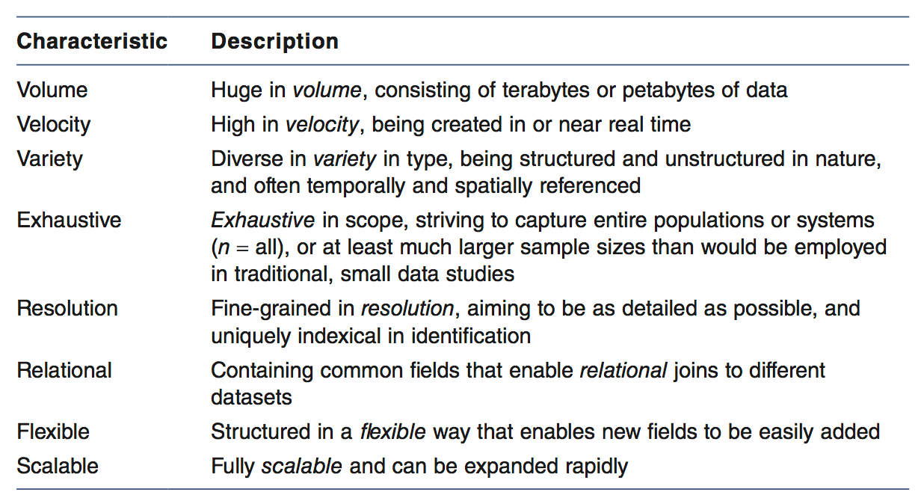
Urban Big Data
Kitchin (2014: 68)

Slide 21
Urban Open Data
Open licensing of data by cities enables use of municipal data without financial cost
Emergence of central repositories that consolidate data
Facilitate discovery and download of assets
Not all cities are able to offer such resources
The arguments for making data open have both an ethical and a pragmatic dimension

Slide 22
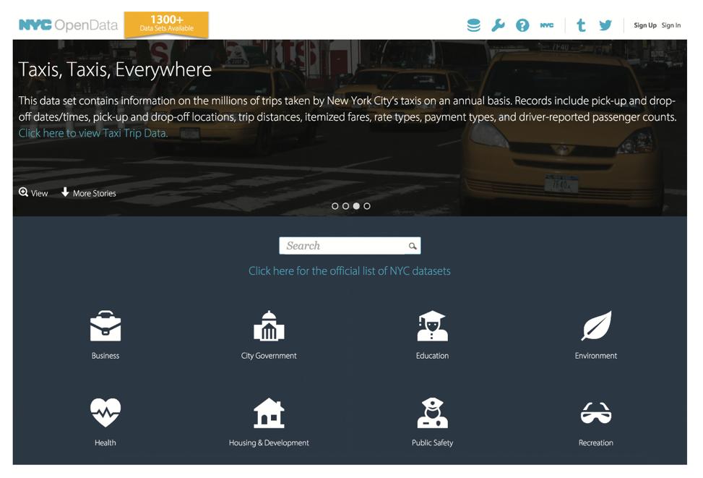
Urban Open Data
NYC Opendata. Many cities across the world now have datastores that provide access to Open Data related to multiple attributes about cities
Source: https://nycopendata.socrata.com/

Slide 23
Conclusions
Urban data enable Urban Analytics
New forms of data
Computational approaches
Gain insight into urban processes
Ask new and often complex questions
Data in itself does not offer insight
Methods are required to both generate and communicate findings.
Urban analytics provides the tools, technologies, and processes for the pursuit of this new data-intensive science of cities.

